Slide 1
Waterways: Better for the Environment, Better for Communities
Highlights of “A Modal Comparison of Domestic Freight Transportation Effects on the General Public: 2001-2019” | January 2022
A study by the Texas Transportation Institute, Center for Ports and Waterways
nationalwaterwaysfoundation.org

Slide 2
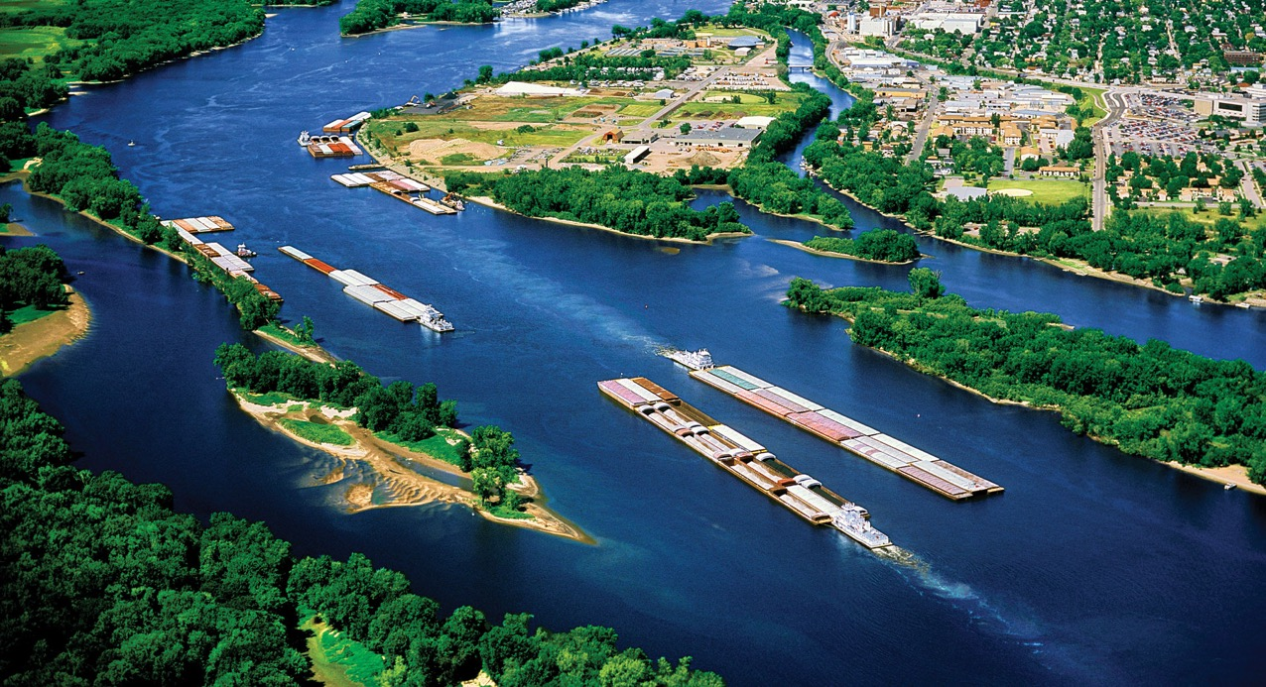
Fuel Efficient and Reliable
America’s inland waterways directly connect 28 states and benefit all 50 states by moving freight the entire country relies upon, all at the lowest cost and with the least fuel consumption.
nationalwaterwaysfoundation.org

Slide 3
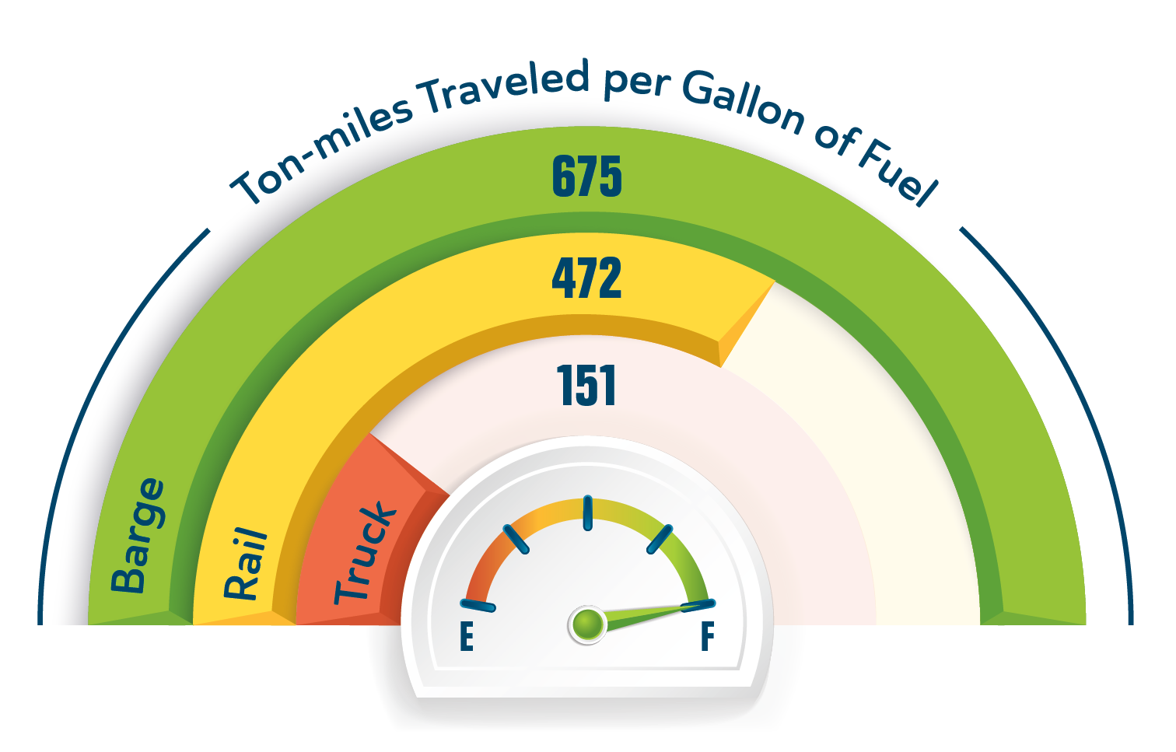
Barges: Most Fuel Efficient
Barges move cargo 675 ton-miles per gallon of fuel. Ton miles per gallon are the measure of how far each ton of cargo is carried by a single gallon of fuel.
A rail car is 30% less efficient than a barge
A truck is 78% less efficient than a barge
nationalwaterwaysfoundation.org

Slide 4
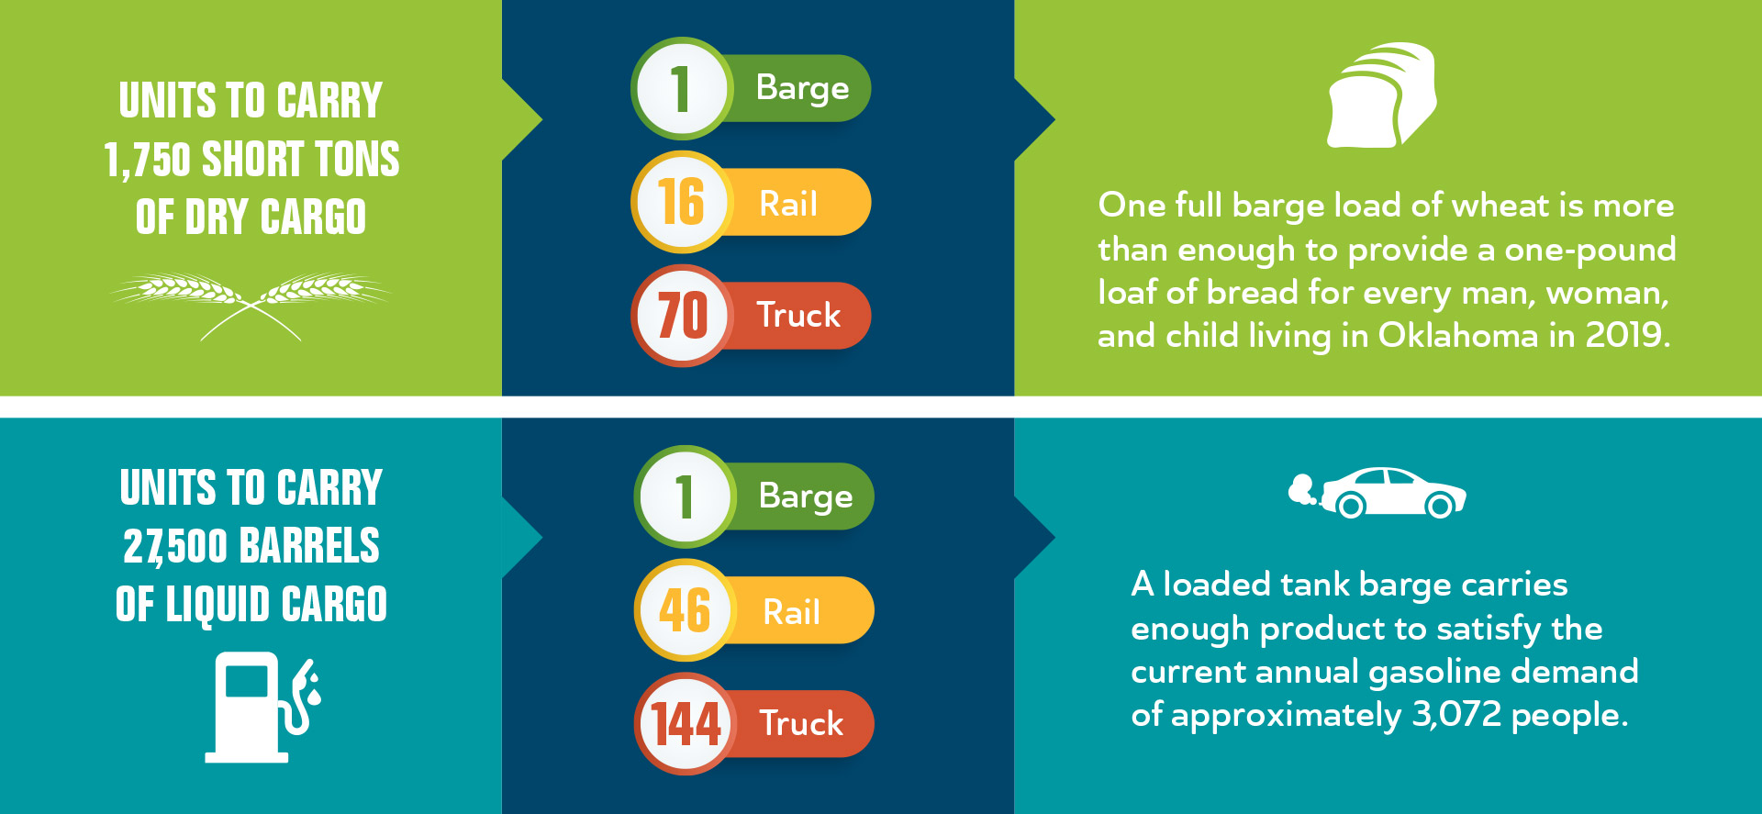
Barges Provide Superior Cargo Capacity
A typical barge transports significantly more cargo than a single truck or rail car.
nationalwaterwaysfoundation.org

Slide 5
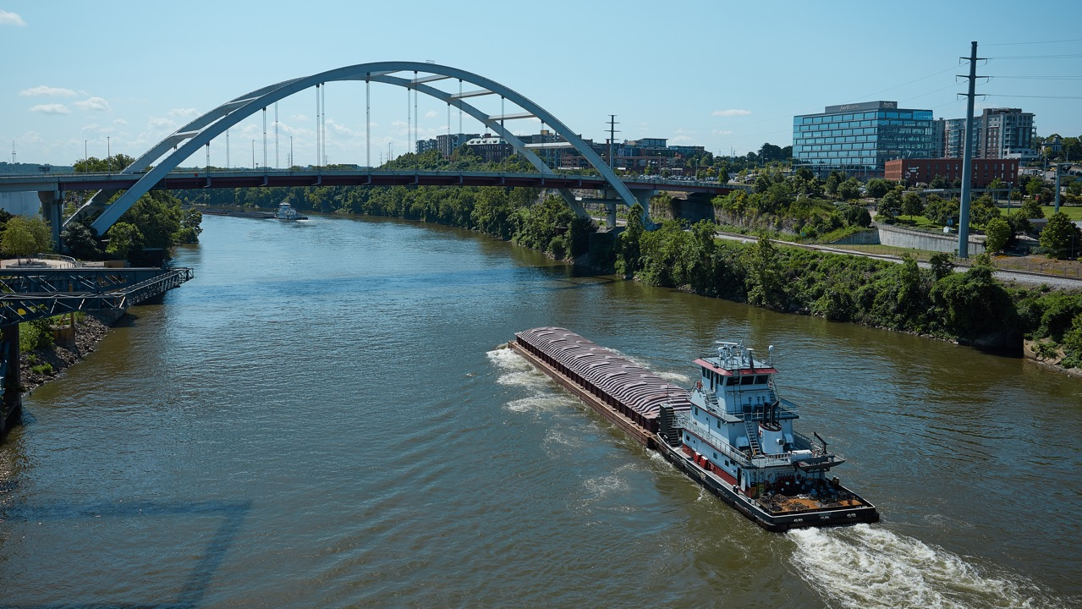
Lowest Carbon Footprint – Least Community Impact
Moving cargo on the inland waterways is the best bet for reducing carbon footprint because barges generate far fewer emissions than trucks or rail. Barge transport also results in fewer spills, which are more than double by truck and nearly three times by rail.
nationalwaterwaysfoundation.org

Slide 6
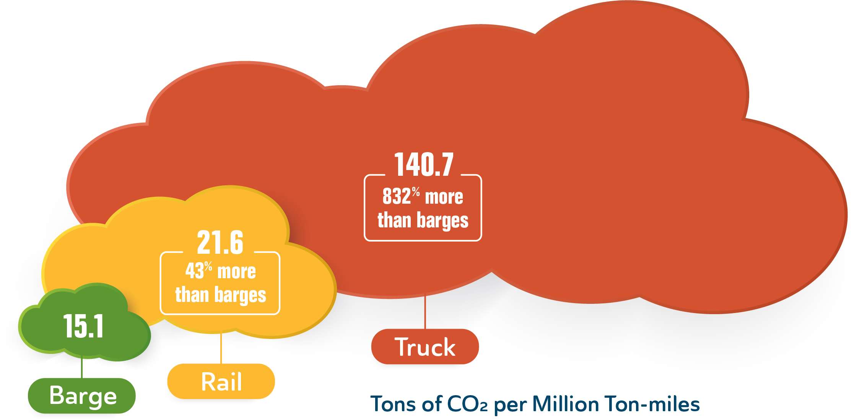
Better For the Environment
Barges have the smallest carbon footprint among competitive transportation modes.
To move an identical amount of cargo by rail generates 43% more carbon dioxide than by barge, and trucks generate over 800% more emissions.
nationalwaterwaysfoundation.org

Slide 7
Protecting Our Communities
Inland waterways transport moves hazardous materials more safely.
All transport modes continuously work hard to prevent accidents, human errors, and other causes of spills. Statistics for 2001-2019 show trucks have 239% and rail cars have 287% more incidents than barges.
nationalwaterwaysfoundation.org

Slide 8
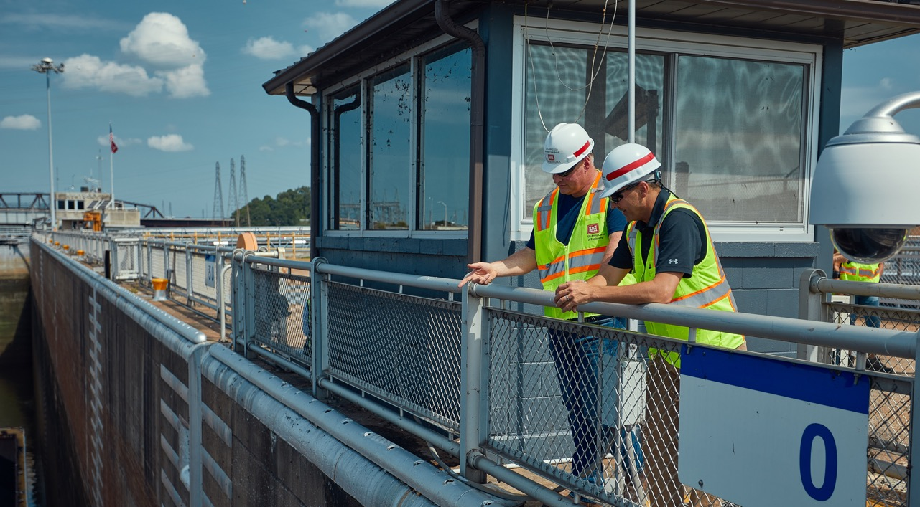
Inland Waterways Move America
Our inland waterways system moves goods more safely and efficiently than rail or highway. It is a key component of the transportation network and essential to our country’s economic strength.
nationalwaterwaysfoundation.org

Slide 9
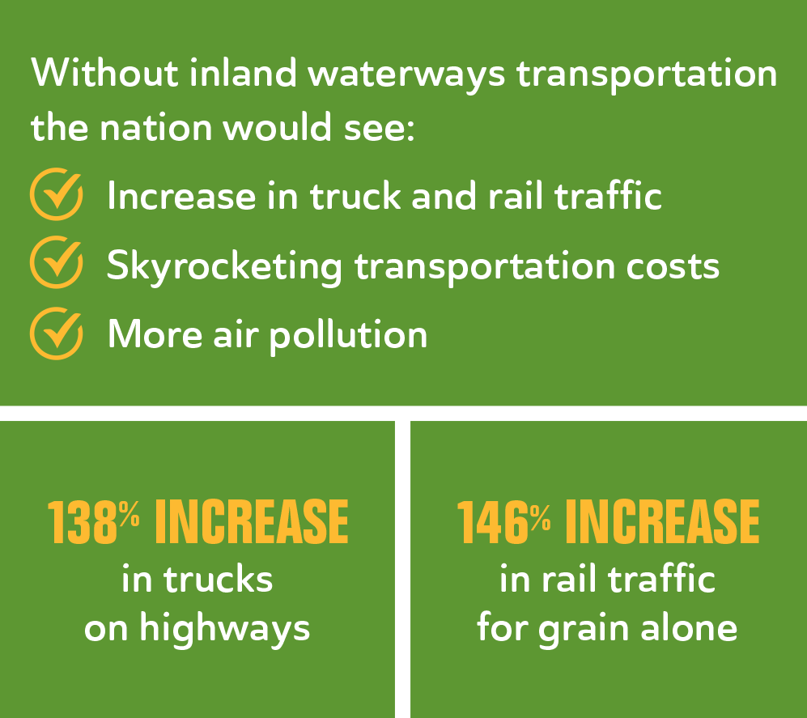
Reducing Traffic Congestion and Lowering Transportation Costs
The inland waterways system includes approximately 12,000 miles of commercially navigable channels and 192 lock sites with 237 chambers that serve navigation. America’s “inland marine highways” ease congestion on roads and rail, carrying critical commodities by barge.
nationalwaterwaysfoundation.org

Slide 10
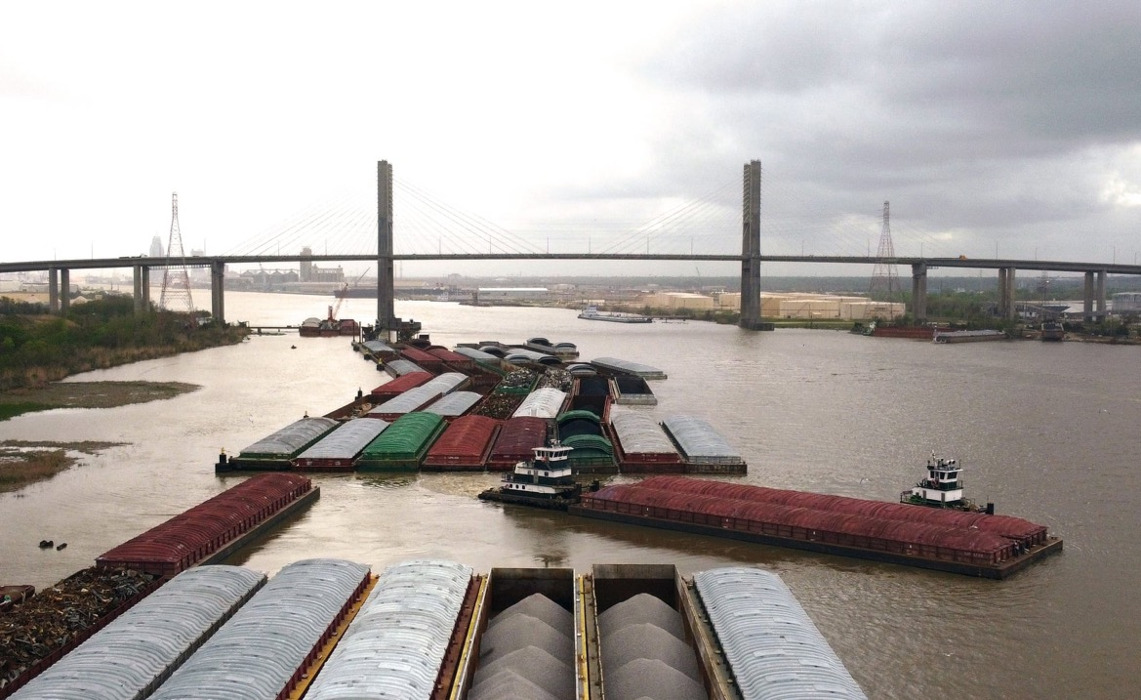
502 Million Tons of Freight Worth More Than $134.1 Billion
Our inland waterways move more than half a billion tons (2019), saving $7-9 billion in transportation costs to the nation compared to truck or rail.
nationalwaterwaysfoundation.org

Slide 11
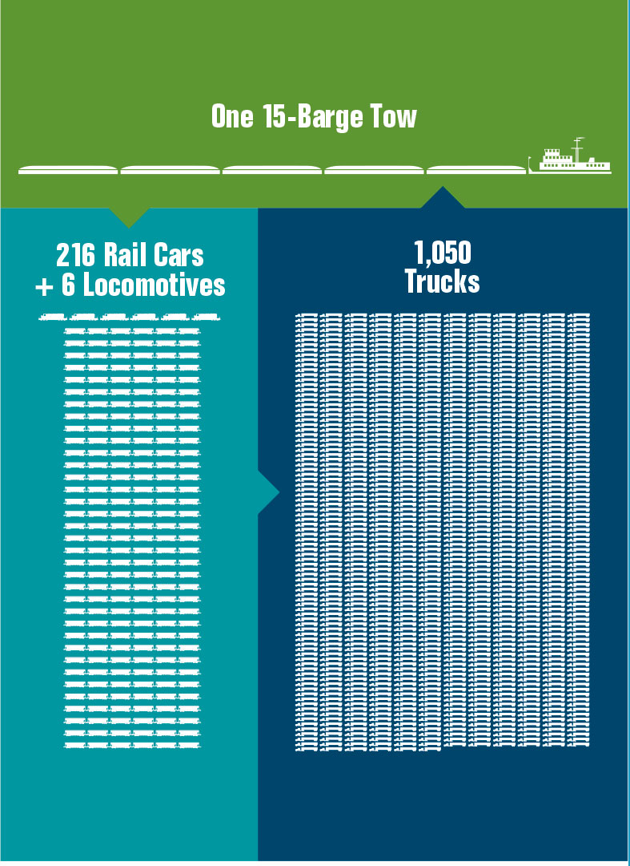
Carrying Capacity of Barges Far Outpaces Rail & Trucks
Waterways transport more than 60% of the nation’s grain exports, about 22% of domestic petroleum and petroleum products, and 20% of the coal used in electricity generation.
• Grain
• Petroleum
• Project Cargoes
• Iron & Steel
• Intermodal Containers
• Chemicals
• Coal
• Aggregates
nationalwaterwaysfoundation.org

Slide 12
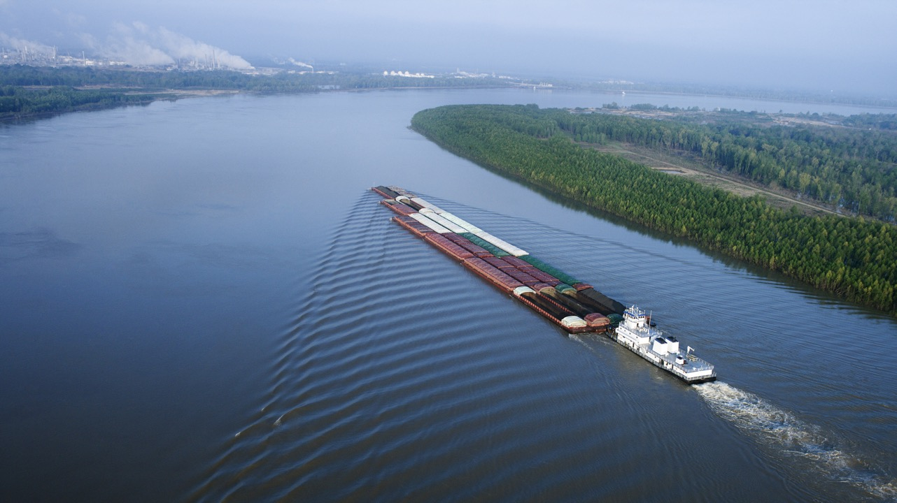
The Safest Mode for Communities
From reducing air pollution to lowering the number of transportation-related injuries and fatalities, inland waterways transport helps to protect people and their environment.
nationalwaterwaysfoundation.org

Slide 13
Staying Alert
Inland waterways transport has the lowest injury rates compared to rail or truck.
Safety related statistics for all modes of freight transportation between 2001-2019 show 1 injury in the inland marine sector for every 95.9 in the rail sector and 1,144.6 in the highway sector.
nationalwaterwaysfoundation.org

Slide 14
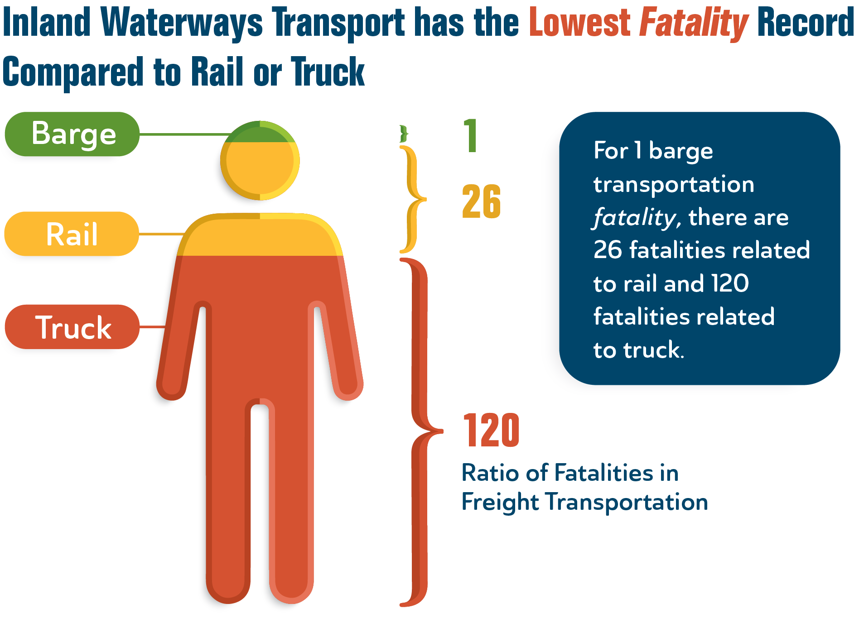
Safety First
Inland waterways transport has the lowest fatality rates compared to rail or truck.
Safety related statistics for all modes of freight transportation between 2001-2019 show
1 fatality in the inland marine sector for every 25.9 in the rail sector and 120.1 in the highway sector.
nationalwaterwaysfoundation.org

Slide 15
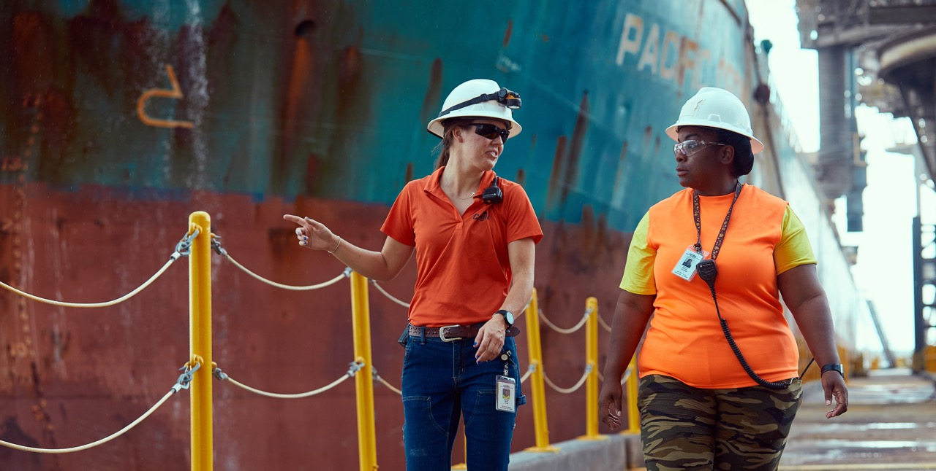
For the full report, visit our website:
nationalwaterwaysfoundation.org

